Slide 1

Aditya-L1
Courtesy: Nunez et al., 2016
K. Sankarasubramanian,
URSC/ISRO
sankark@ursc.gov.in

Slide 2
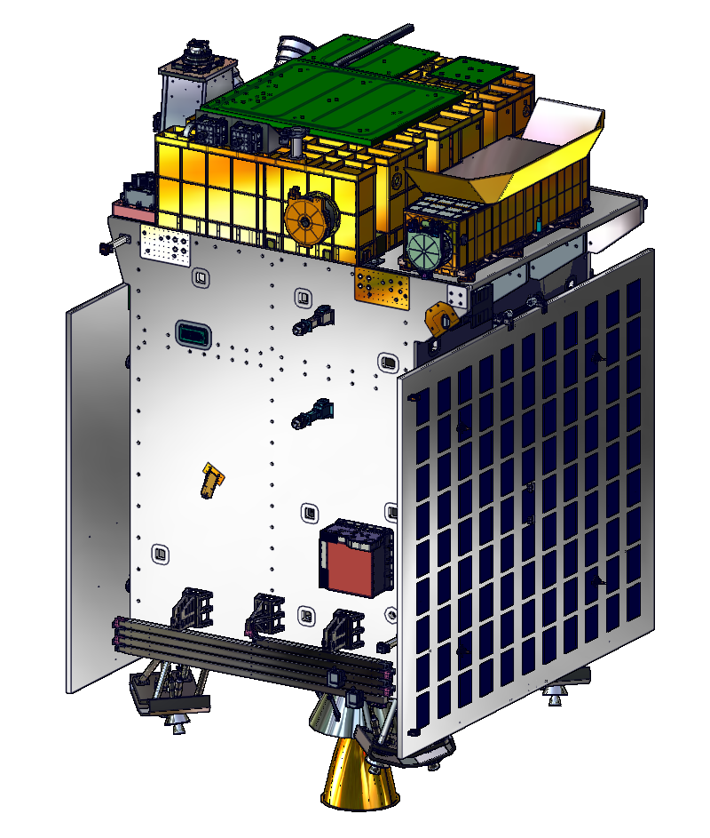
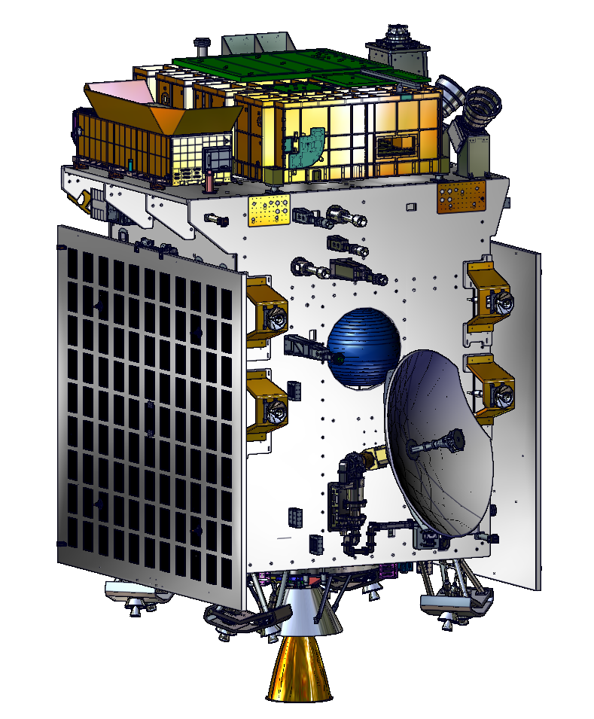
Aditya-L1
VELC
(IIA)
SWIS
(PRL)
SUIT
(IUCAA)
HEL1OS
(URSC)
SoLEXS
(URSC)
STEPS-2(A)
(PRL)
MAGNETOMETER
(URSC)
PAPA
(VSSC)
STEPS-2(B)
(PRL)
+R
-Y
STOWED VIEWS
+P

Slide 3
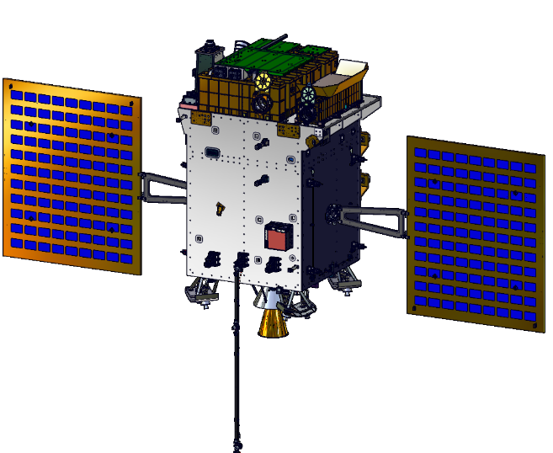
Remote Sensing Payloads:
VELC, SUIT, SoLEXS & HEL1OS
In-situ Payloads:
PAPA, ASPEX & MAG
Aditya-L1 to provide observations of:
Through remote sensing -
Dynamical events on the Sun such as CMEs, Solar Flares etc
Through in-situ –
Study those events crossing through L1, ahead of Earth
Deployed View

Slide 4
Proposed Primary Science Goals
Address plasma diagnostics of large and small-scale structures in the corona
Address origin and dynamics of CME's and Flares → drivers for space weather models
Explore Coronal magnetic topology & Active region Coronal magnetic fields
Coronal Abundance studies & FIP variations during solar flares
Prominence Studies → Quiescent and eruptive prominences
Measure and monitor the spatially resolved solar spectral irradiance in the Near UV
Study the directional and energy anisotropy of solar wind using Multi-direction observations
Origin of supra-thermal and energetic particles → isolate the flare related accelerated energetic particles to that of CME shock related

Slide 5
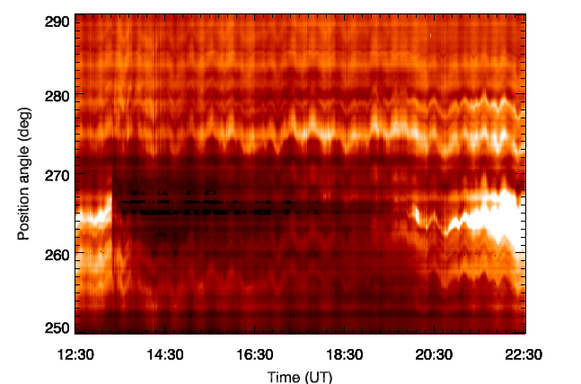
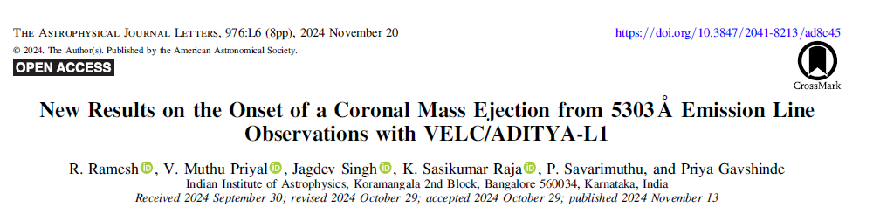
Capability – CME Dynamics
Dimming
The dimming observed in the present case
is due to CME-induced depletion of coronal material
Probably the first dimming detection in the Green line emission due to CME; earlier dimming are observed in EUV and X-rays
13:18
CME in the SOHO/LASCO FOV estimates that its onset time at r = 1 Re is ≈13:48 UT (second order fit to h-t plot).
The corresponding time, based on linear fit is ≈12:36 UT.
More details of VELC: Last Talk
Published in ApJL
Notes:
Primary Science Goals of the Mission

Slide 6
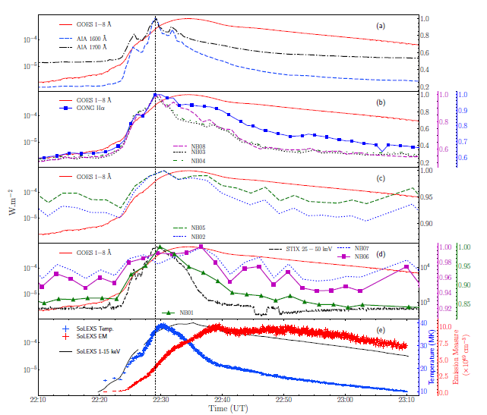
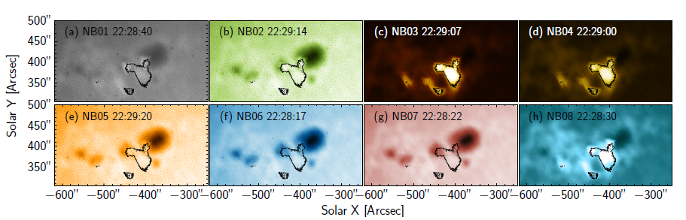
Capability – Flare
(First Multi-Payload Science from Aditya-L1)
SUIT Multi-filter observation of the Flare
1 | NB01 | 214
2 | NB02 | 276.7
3 | NB03 | 279.6
4 | NB04 | 280.3
5 | NB05 | 283.2
6 | NB06 | 300
7 | NB07 | 388
8 | NB08 | 396.85
To the best of our knowledge, this is the first such observation in the blue wing of Mg II (NB02 filter; Deeper in chromosphere)
Near and Mid Ultra Violet Observations of X-6.3 flare recorded by the Solar Ultraviolet Imaging Telescope on 22nd February, 2024
Soumya Roy, Durgesh Tripathi, Sreejith Padinhatteeri, A. N. Ramaprakash, Abhilash R. Sarwade, Nived V. N., Janmejoy Sarkar, Rahul Gopalakrishnan, Rushikesh Deogaonkar, K. Sankarasubramanian, Sami K. Solanki, Dibyendu Nandy, and Dipankar Banerjee
Under review ApJL
Notes:
Primary Science Goals of the Mission

Slide 7
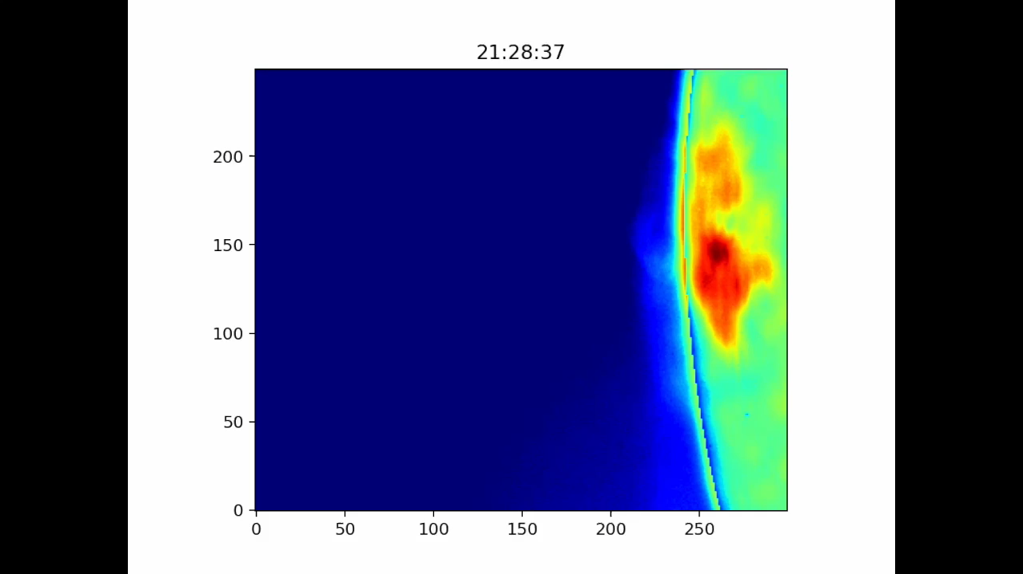
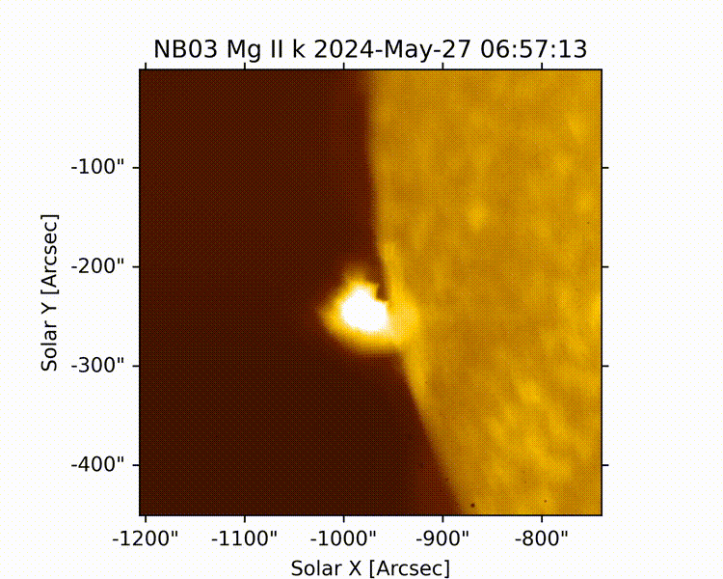
Flare Science from Aditya-L1
Capability – On-board Flare Detection and Mode change
2023 New Year Eve Flare
X-class flares &CMEs: Couple of Examples
In preparation for ApJL

Slide 8
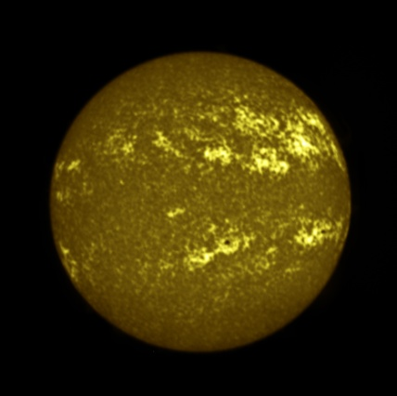
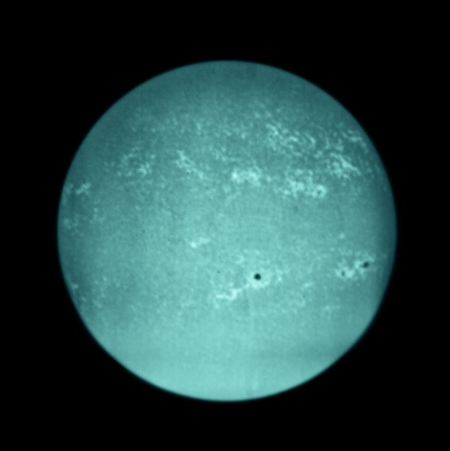
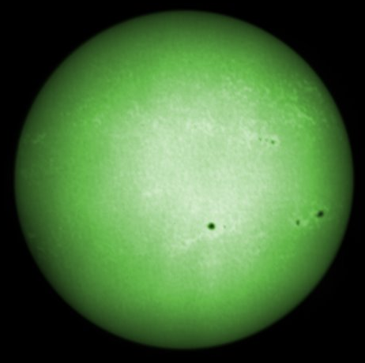
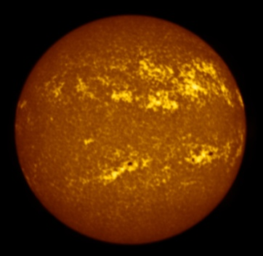
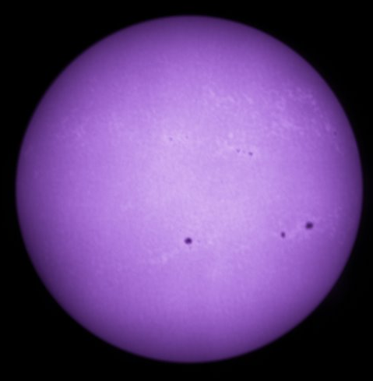
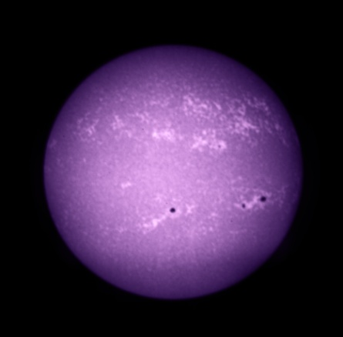
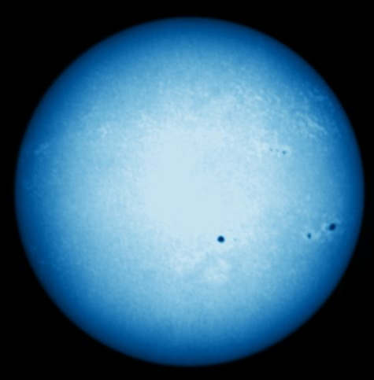
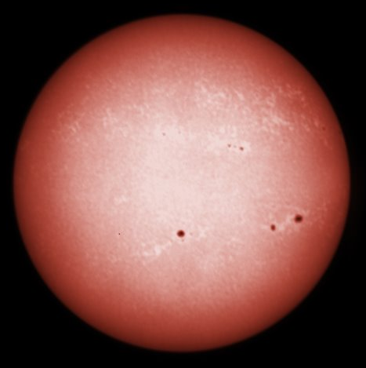
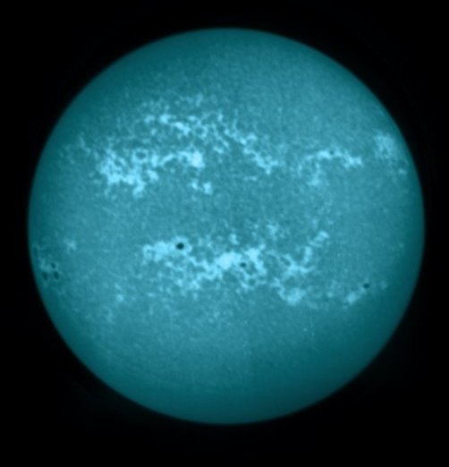
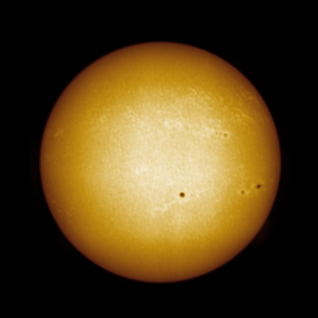
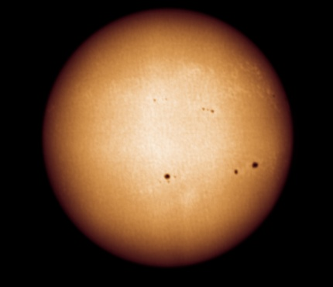
Full Disk Images from SUIT
NB01
NB02
NB03 Mg II k
NB04 Mg II h
NB05
NB06
NB07
NB08
BB01
BB02
BB03
Capability – Spatially Resolved
NUV Full Disk Images

Slide 9
Observation modes
Synoptic mode | Flare mode | Custom mode
Full resolution (4k X 4k) All science filters Every 2.5 hours. | Flare Flags: SUIT Binned images, SoLEXS, HEL1OS. | Tailored configurations beyond predefined modes.
2 x 2 binned full disk: Mg II h (NB04) Every minute. | Partial disk view of the flaring region. | Custom filter selection Custom cadence Custom RoI.
Region of interest. ~64 s cadence for each filter. All filters. | Onboard region of interest localization, tracking, and auto exposure adjustments. | Limited only by payload data budget and operational constraints.
In regular use. | In regular use. | Prog seq made with request from team members. Tested and demonstrated.

Slide 10
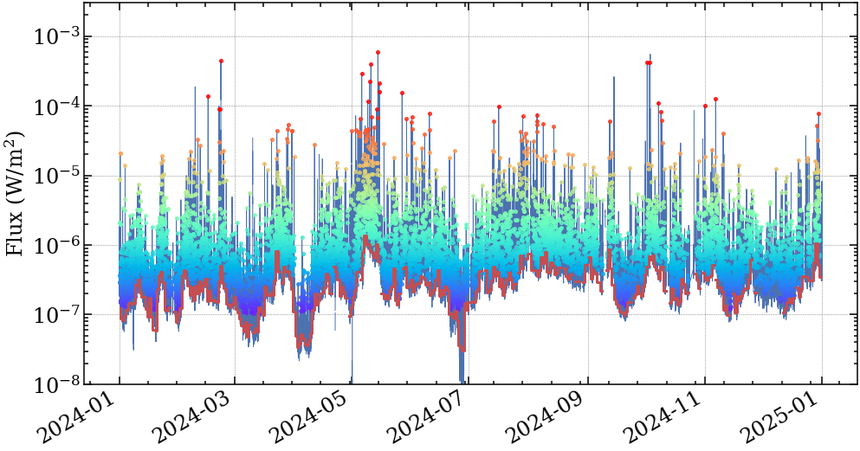
Uninterrupted Flare Observations

Slide 11
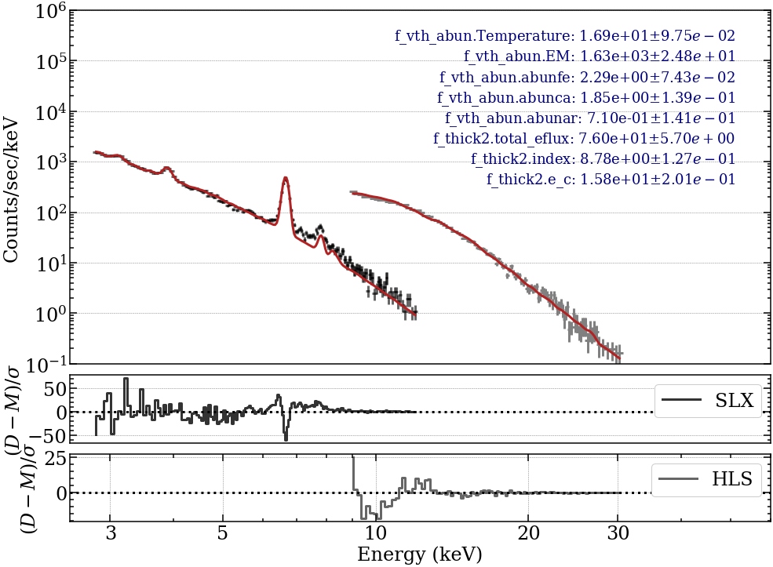
Solar Flare X-ray Spectra
A unique combination of experiment for uninterrupted Solar Flare studies

Slide 12
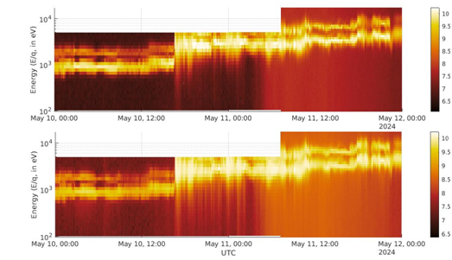
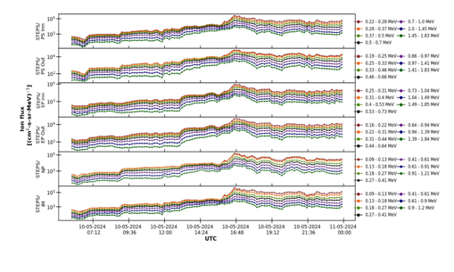
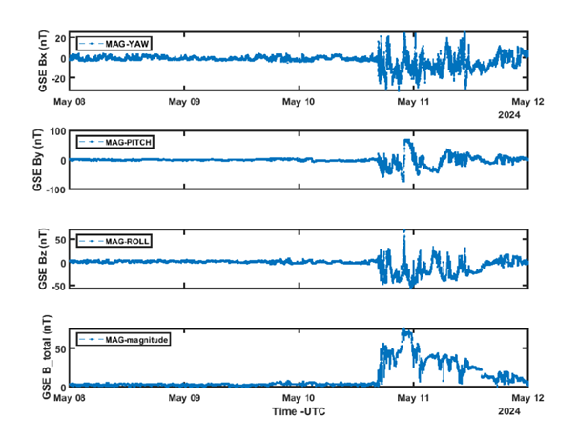
In-situ Experiments: May 11th Event
Capability – Directional Measurement
Along with Magnetic Field

Slide 13
Science Uniqueness of Aditya-L1
CME dynamics close to the disk (1.05Rsun) providing information in the acceleration regime which is not observed consistently
Spatially resolved solar disk observations in the near UV providing information on the radiation output from different structures
On-board intelligence for Flares - optimized observations and data volume
Flare observations→ all flares observed without break or sensitivity change
Solar wind electrons, protons, and alpha particles fluxes with direction information
Aditya-L1 Topical Collection: Solar Physics, 2025

Slide 14
Proposed & Achievable Science Cases
Address plasma diagnostics of large and small-scale structures in the corona
Address origin and dynamics of CME's and Flares → drivers for space weather models
Explore Coronal magnetic topology & Active region Coronal magnetic fields
Coronal Abundance studies & FIP variations during solar flares
Prominence Studies → Quiescent and eruptive prominences
Measure and monitor the spatially resolved solar spectral irradiance in the Near UV
Study the directional and energy anisotropy of solar wind using Multi-direction observations
Origin of supra-thermal and energetic particles → isolate the flare related accelerated energetic particles to that of CME shock related

Slide 15
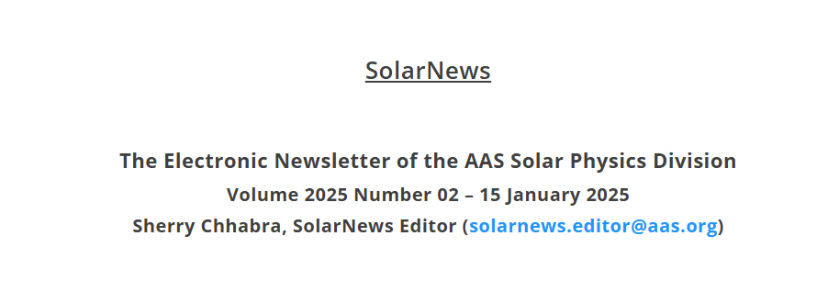
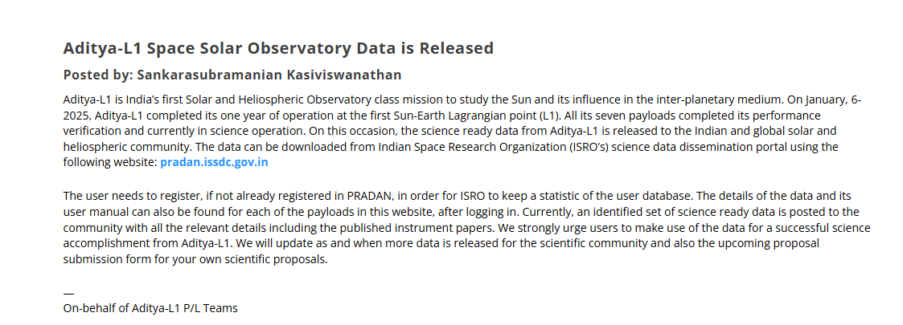

Slide 16
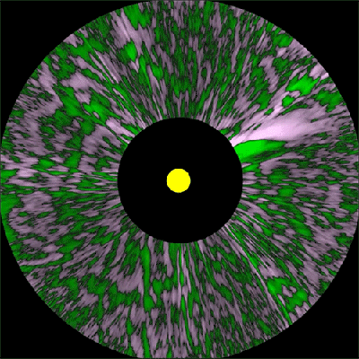

Synergy with Other Observatories
2025 will add new solar & Heliophysics missions
  Proba-3, PUNCH, IMAP, and SWFO-L1
Joint Observation Campaign – SO, SPP, Proba-3, PUNCH, CCOR, IMAP, and SWFO-L1
It’s an exciting time to be a Solar and/or Helio-physicist
PUNCH
CCOR
Aditya-L1
10% of Aditya-L1 observatory time will be available for Multi-observatory proposal

